Slide 2
Artificial Intelligence: Impact and Ethical Implications
This presentation provides an overview of how Artificial Intelligence has revolutionized different industries and its impact on employment. It also discusses the growing ethical concerns related to AI development.

Slide 3
Introduction to Artificial Intelligence
AI has rapidly transformed the present age with its numerous applications.
Revolutionized industries such as healthcare, finance, and transportation, among others.
Improved efficiency, accuracy, and productivity to increase revenue for businesses.

Slide 4
Benefits of AI in Healthcare, Finance, and Transportation
In healthcare, AI-powered systems have enabled faster and more accurate diagnoses, improved patient outcomes, and reduced healthcare costs.
In finance, AI has facilitated fraud detection, risk management, and personalized customer experiences.
In transportation, autonomous vehicles have the potential to reduce accidents and traffic congestion while improving fuel efficiency.

Slide 5
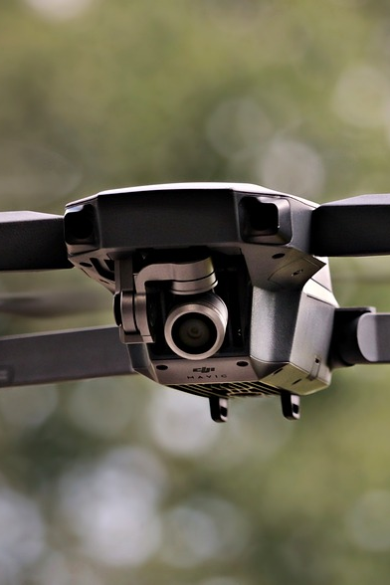
Impact of AI on Employment
The potential to displace jobs across various sectors due to automation.
The need for upskilling and reskilling to adapt to the changing job market.

Slide 6
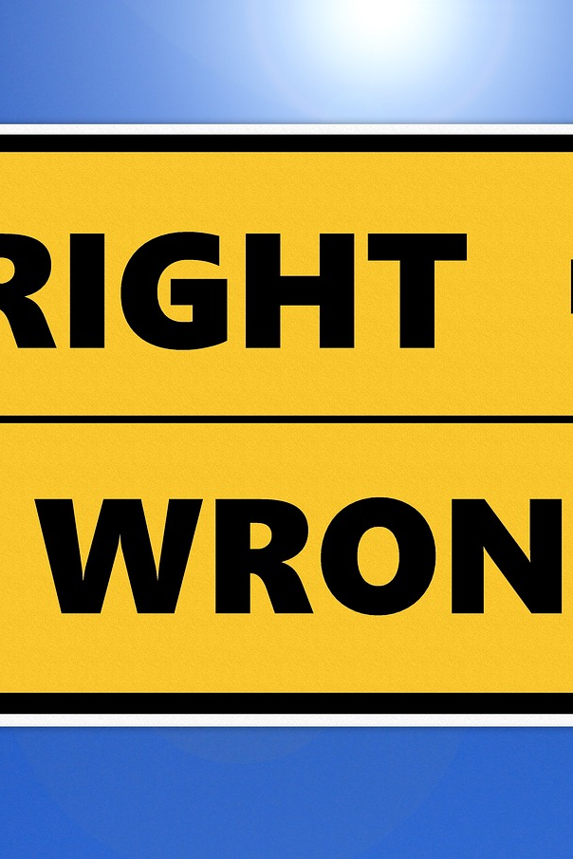
Ethical Concerns in AI Development
The potential for bias in AI algorithms leading to discrimination.
Lack of transparency in AI decision-making processes.

Slide 7

AI Bias and Discrimination
Bias can lead to discrimination against certain groups or individuals.
Ensuring AI algorithms are developed with diverse datasets and tested for bias regularly.

Slide 8

AI Transparency and Accountability
AI systems should be explainable and accountable, especially in critical decision-making areas such as healthcare and finance.
Ensuring that AI development is guided by ethical principles.

Slide 9

Addressing the Ethical Implications of AI
Ensuring that organizations are aware of the potential ethical implications of AI.
Developing and adhering to ethical guidelines and principles in AI development.

Slide 10

Conclusion
AI has had a significant impact on various industries.
The need to address ethical concerns associated with AI development.

Slide 11
Thank you for your time 😊

